Slide 1
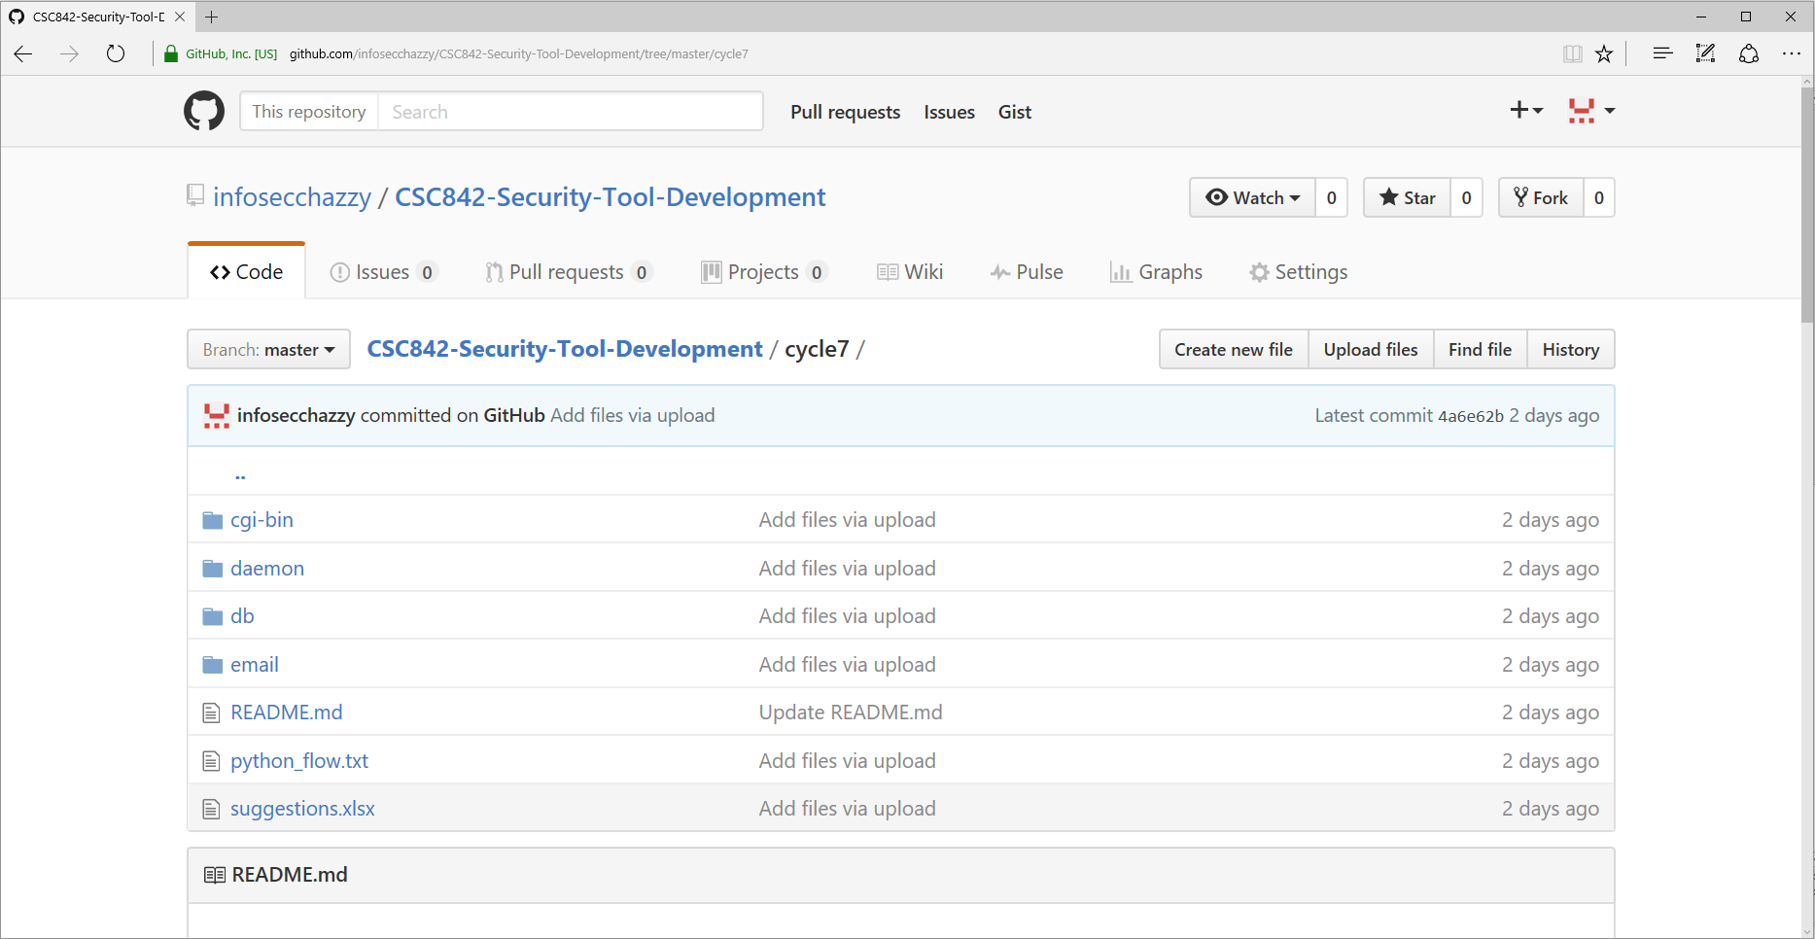
Student Monitoring – Cycle 7

Slide 2
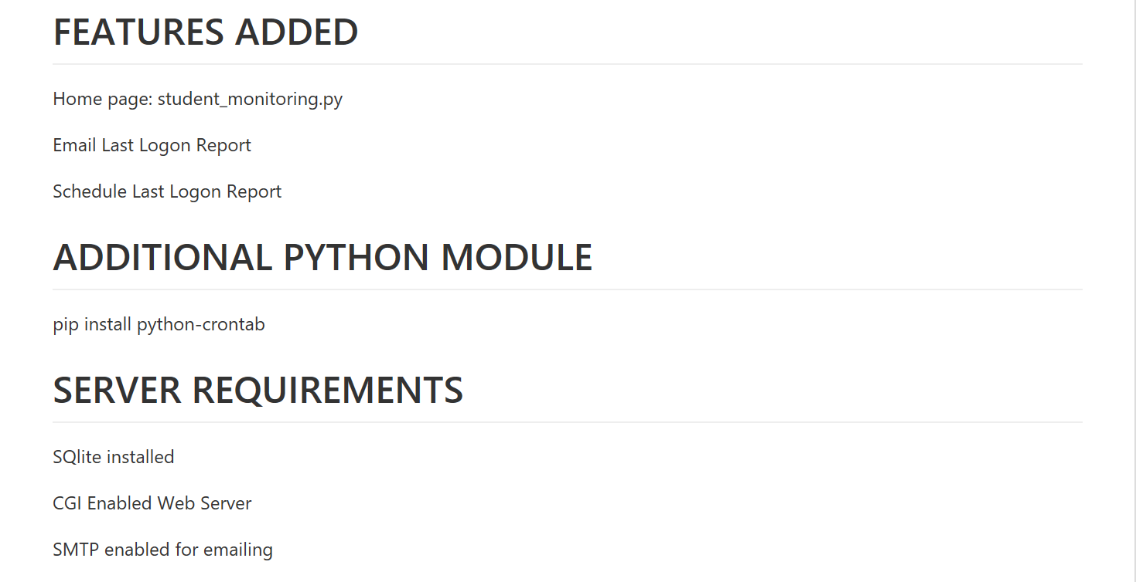

Slide 3
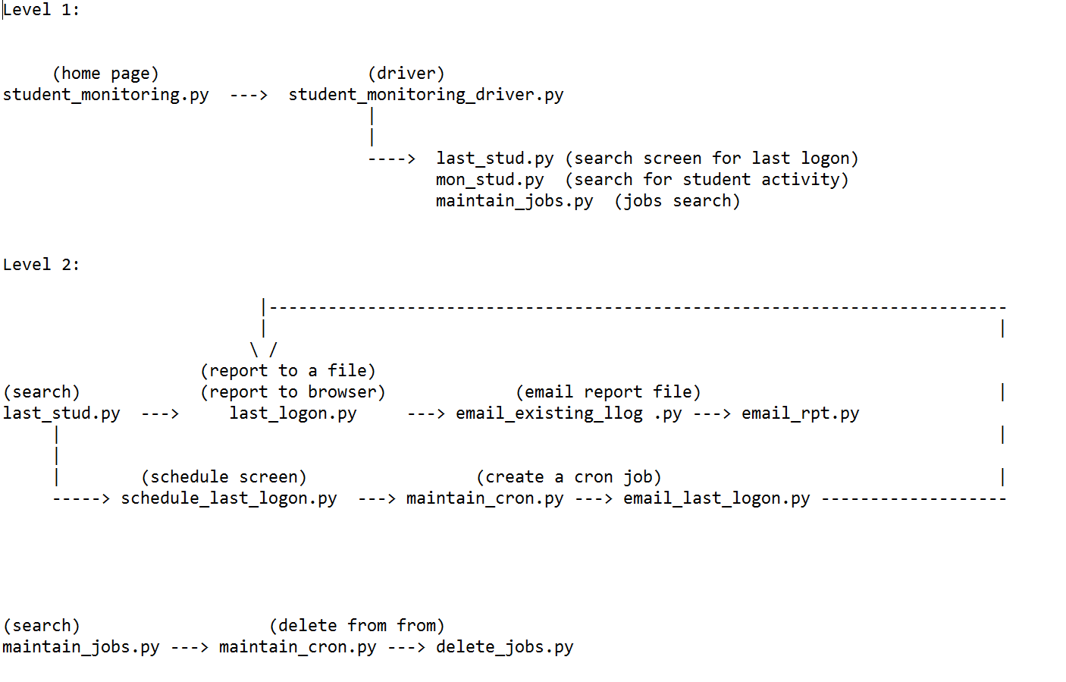
Python Flow

Slide 4
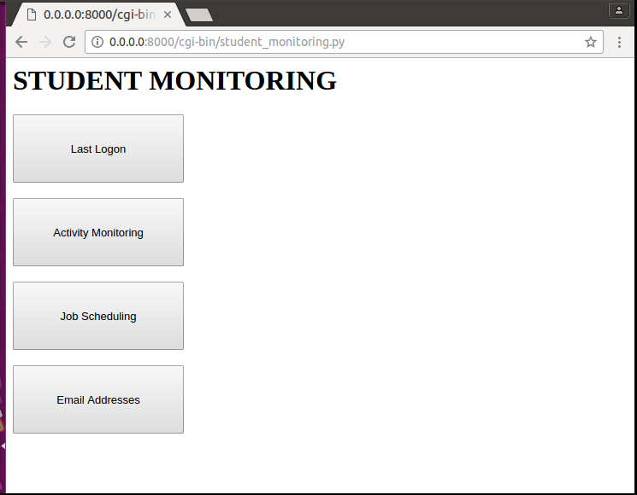
Home Page

Slide 5
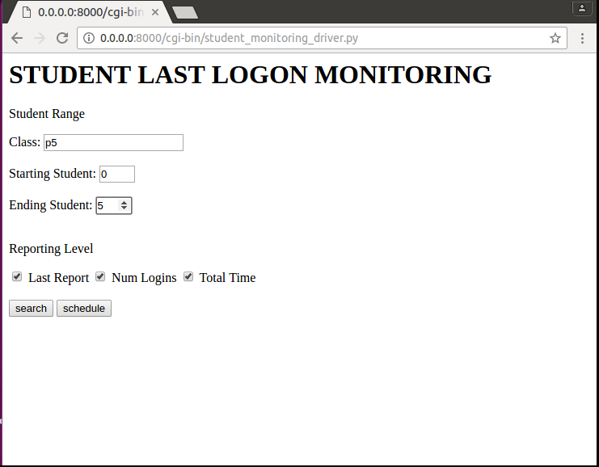
Last Logon Search

Slide 6
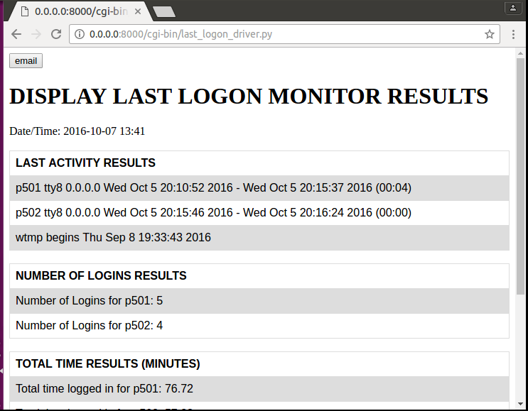
Last Logon Report

Slide 7
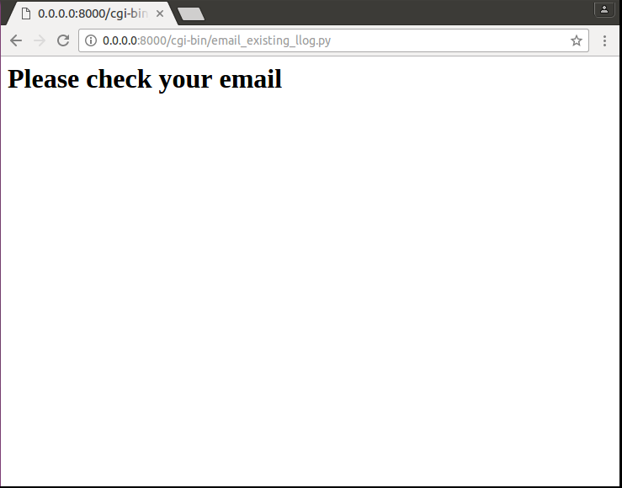
Email Report

Slide 8
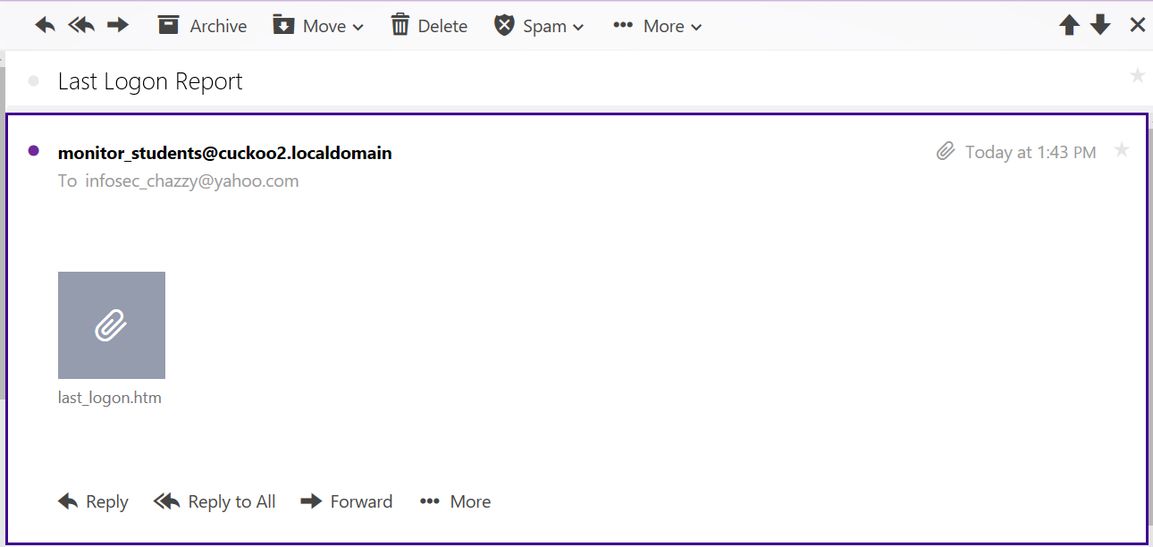
Email

Slide 9
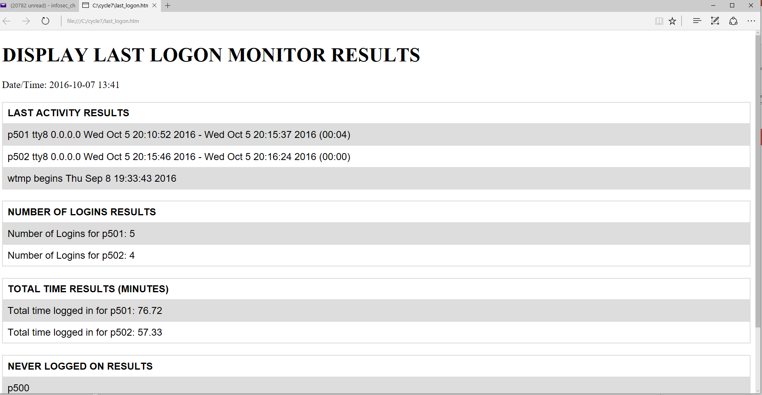
HTML File

Slide 10
Last Logon Search

Slide 11
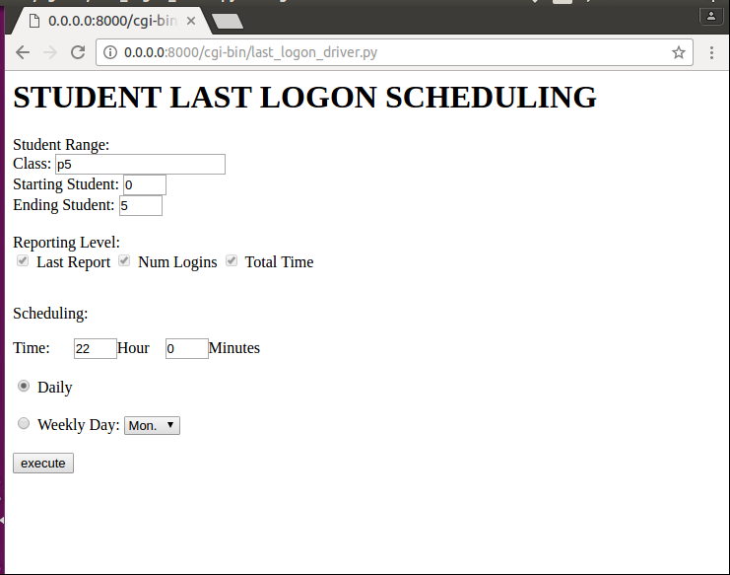
Schedule

Slide 12
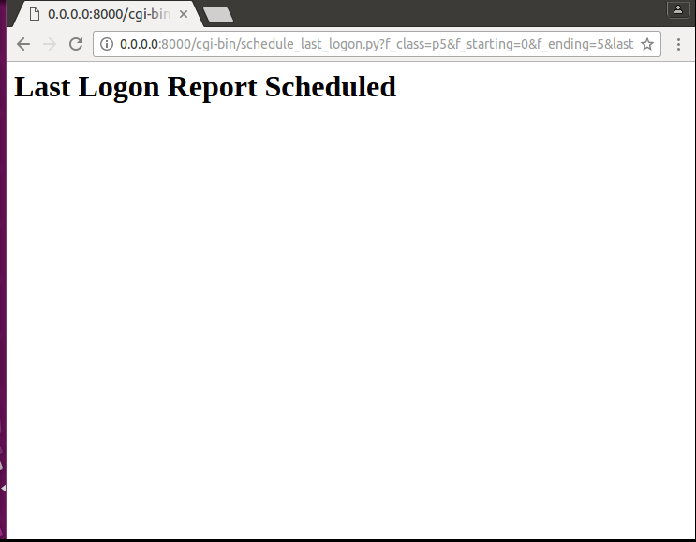

Slide 13

CRON Scheduled Job

Slide 14
Home Page

Slide 15
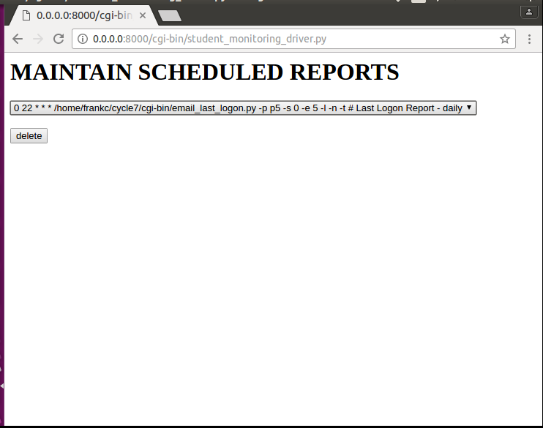
Maintain Scheduled Reports

Slide 16
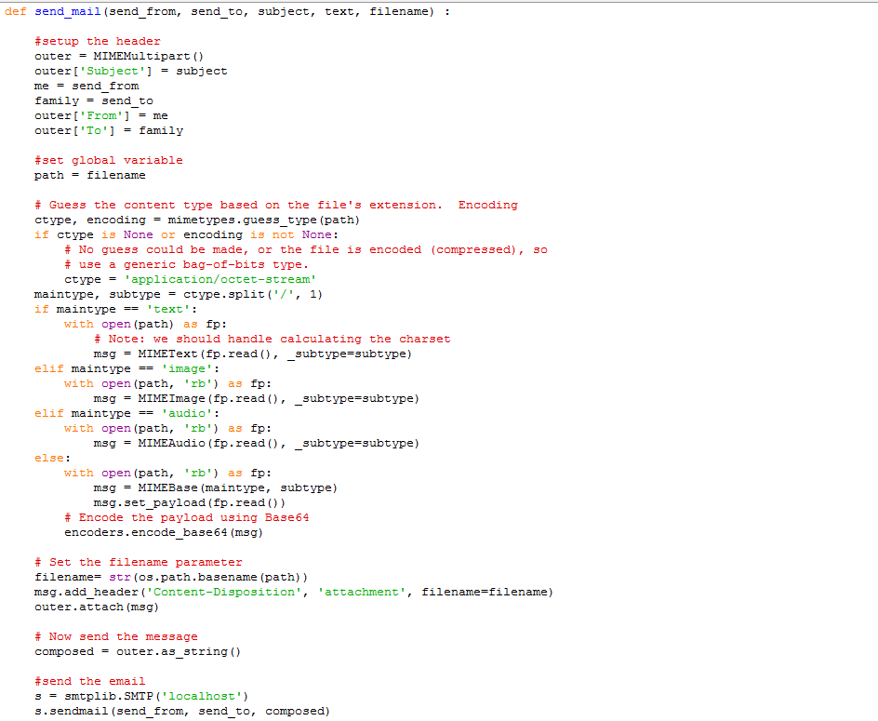
Some PYTHON

Slide 17
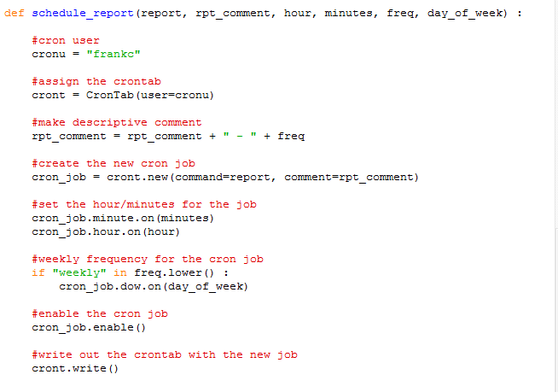
Some PYTHON

